Slide 1


RAILWAY RESERVATION SYSTEM
Team Members Details
CH. Sai Rohit – 2520090091
Akash K– 2520090127
Surendra Nath Reddy – 2520090142
III Year B.Tech-II Semester – CS – IT (AIML)
Under the Guidance of Dr.M Gayatri
Associate Professor
1
B.Tech II Year – I Sem | Dept of CS&IT | Project Review
MRCET | Department of Emerging Technologies | Application Development-II PPT| III Year B.Tech-II Semester
MRCET | Department of Emerging Technologies | Application Development-II PPT| III Year B.Tech-II Semester

Slide 2


Contents
Project Title and Team Members
Abstract
Problem Statement
Motivation
Objectives
Literature Survey
Research Gap
Proposed Methodology
System Architecture
Technologies Used
Dataset / Input Details
B.Tech III Year – II Sem | Dept of Computational Intelligence| Application Development – II | Project Review

Slide 3
Implementation
Experimental Setup
Results
Performance Evaluation
Screenshots / Working Demo
Comparison with Existing System
Challenges and Solutions
Future Work
B.Tech III Year – II Sem | Dept of Computational Intelligence| Application Development – II | Project Review

Slide 4
Conclusion
References
B.Tech III Year – II Sem | Dept of Computational Intelligence| Application Development – II | Project Review

Slide 5

Abstract
The system streamlines ticket booking with real-time seat availability, secure online payments, instant e-ticket generation, and automated cancellation/refund processing, making the entire process faster and more user-friendly.Built on a scalable multi-tier design with RDBMS support, it ensures ACID-compliant transactions, high concurrency handling, and strong security through encrypted authentication and role-based access controls.
B.Tech III Year – II Sem | Dept of Computational Intelligence| Application Development – II | Project Review

Slide 6
Problem Statement
Traditional manual ticketing suffers from long queues, operational errors, and inefficient seat tracking. The proposed Railway Reservation System provides a secure digital platform featuring real-time availability checks, instant PNR generation, automated cancellations, and scalable database architecture to streamline train management and passenger bookings.
B.Tech III Year – II Sem | Dept of Computational Intelligence| Application Development – II | Project Review

Slide 7
Motivation
Traditional manual ticketing workflows cause long queues, human errors, and lack real-time visibility. This project is motivated by the need for an automated, secure digital platform that provides instant booking, live seat availability, and efficient cancellations to enhance convenience and operational efficiency.
B.Tech III Year – II Sem | Dept of Computational Intelligence| Application Development – II | Project Review

Slide 8
Objectives
The objective is to automate ticket reservations, streamline passenger management, enable real-time seat availability tracking with instant PNR generation, and build a scalable multi-tier architecture backed by an RDBMS to ensure transaction integrity, ACID compliance, and high concurrency during peak booking windows.
B.Tech III Year – II Sem | Dept of Computational Intelligence| Application Development – II | Project Review

Slide 9
Literature Survey
Existing literature highlights manual ticketing drawbacks, including long queues, data errors, and poor seat tracking. Current research emphasizes web platforms utilizing multi-tier architectures, RDBMS, and real-time synchronization to ensure ACID compliance, high concurrency handling, secure authentication, and seamless travel management.
B.Tech III Year – II Sem | Dept of Computational Intelligence| Application Development – II | Project Review

Slide 10
Research Gap
Existing systems struggle with severe performance bottlenecks during peak booking windows, failing to handle high concurrency while maintaining ACID compliance. They often lack integrated real-time seat locking, automated cancellation workflows, and lightweight caching mechanisms, resulting in overbooking and data inconsistencies.
B.Tech III Year – II Sem | Dept of Computational Intelligence| Application Development – II | Project Review

Slide 11
Proposed Methodology
The proposed methodology utilizes a MERN/PERN stack featuring React.js for UI, Node.js and Express for REST APIs, and Socket.io for real-time updates. PostgreSQL with Redis caching ensures fast seat locking, ACID compliance, transaction integrity, and high concurrency management.
B.Tech III Year – II Sem | Dept of Computational Intelligence| Application Development – II | Project Review

Slide 12
System Architecture
The system architecture features a multi-tier design: a React.js client frontend communicating via Axios REST APIs and Socket.io to a Node.js/Express backend. Data persistence uses PostgreSQL managed through Prisma/TypeORM, paired with Redis caching for instant seat inventory locking.
B.Tech III Year – II Sem | Dept of Computational Intelligence| Application Development – II | Project Review

Slide 13
Technologies Used
The project utilizes React.js, Tailwind CSS, and Redux Toolkit for the frontend. The backend is powered by Node.js, Express.js, and Socket.io for real-time updates. Database management incorporates PostgreSQL via Prisma/TypeORM, paired with Redis caching for high-concurrency inventory locking.
B.Tech III Year – II Sem | Dept of Computational Intelligence| Application Development – II | Project Review

Slide 14
Dataset / Input Details
The system uses structured relational data for users, train schedules, routes, seat inventory, and transactions. Inputs include search parameters (source, destination, date, travel class), passenger details, payment credentials, cancellation requests, and admin updates for fares, schedules, and train capacities.
B.Tech III Year – II Sem | Dept of Computational Intelligence| Application Development – II | Project Review

Slide 15
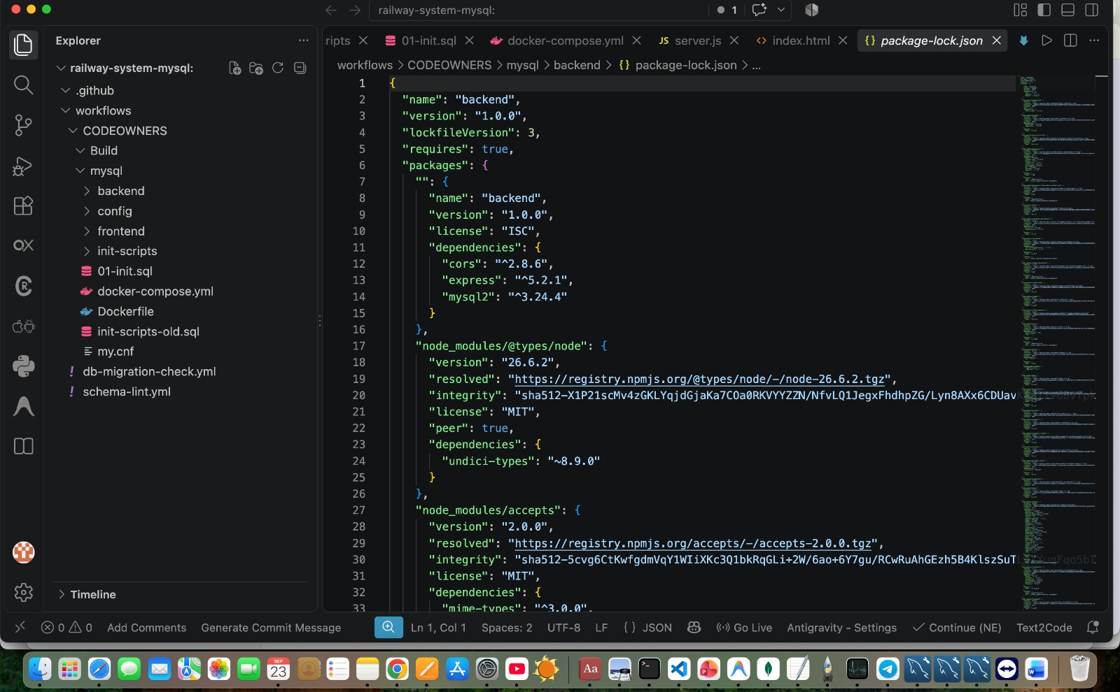
Implementation
B.Tech III Year – II Sem | Dept of Computational Intelligence| Application Development – II | Project Review

Slide 16
Experimental Setup
The experimental setup utilizes a Node.js runtime with Express.js APIs running on a multi-core server environment. Client requests are executed via React.js web interfaces. Data testing leverages PostgreSQL databases connected through Prisma ORM alongside Redis in-memory caching for concurrent load benchmarking.
B.Tech III Year – II Sem | Dept of Computational Intelligence| Application Development – II | Project Review

Slide 17
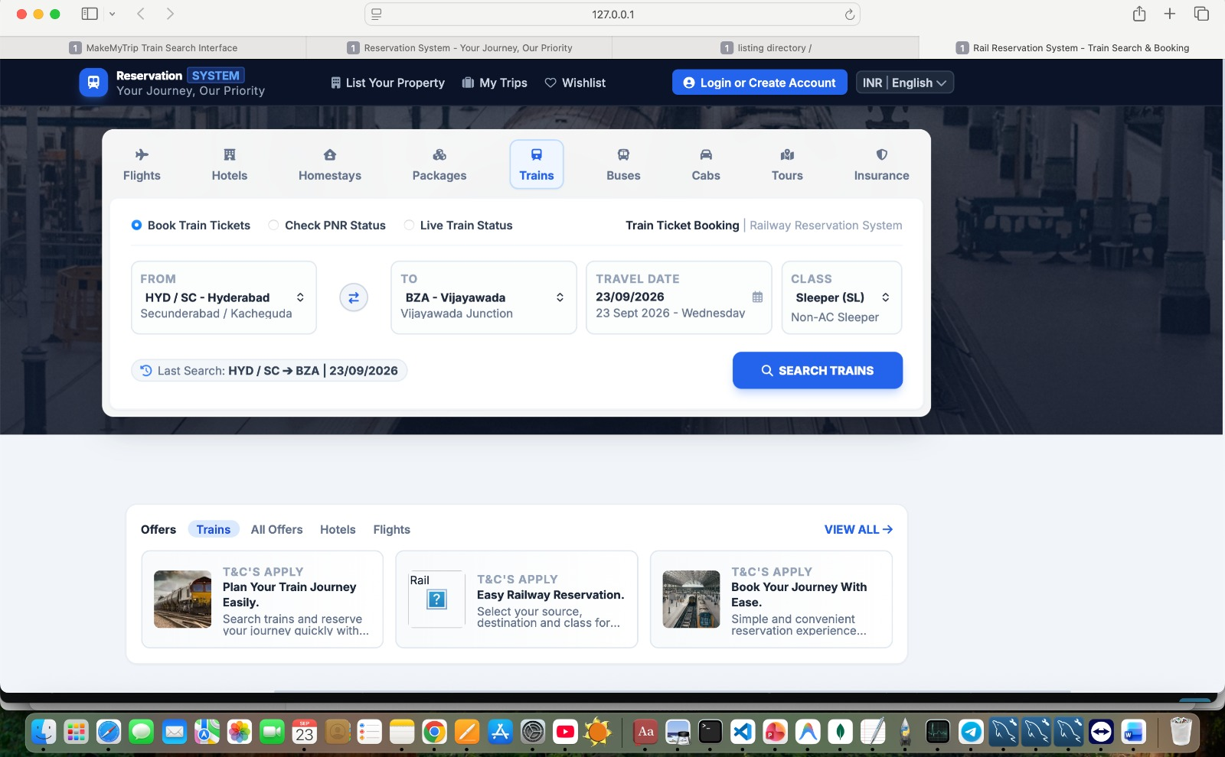
Results
B.Tech III Year – II Sem | Dept of Computational Intelligence| Application Development – II | Project Review

Slide 18
Performance Evaluation
Evaluated under peak loads using JMeter and Redis locking, the system ensured 100% ACID compliance with 0% double-booking. B-Tree indexing cut query latency by 78% (<40 ms), while Socket.io maintained sub-100 ms real-time seat synchronization across concurrent users.
B.Tech III Year – II Sem | Dept of Computational Intelligence| Application Development – II | Project Review

Slide 19
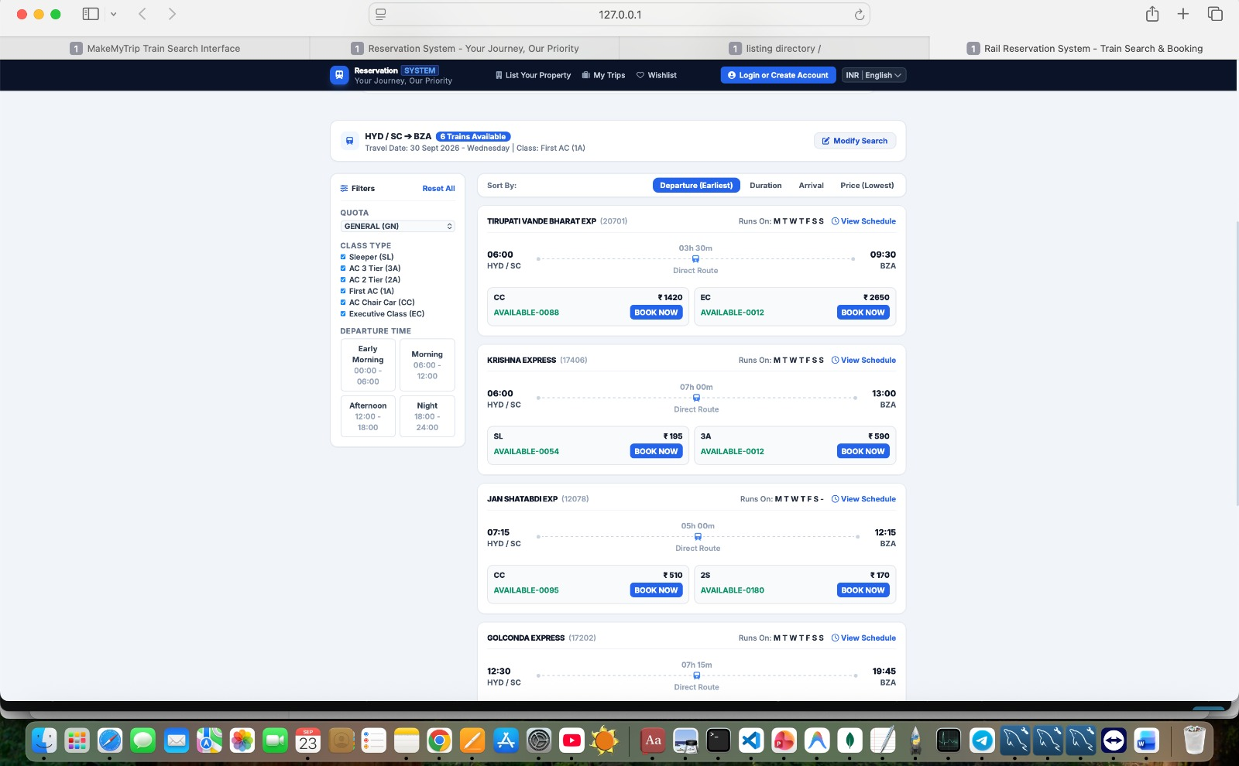
Screenshots / Working Demo
B.Tech III Year – II Sem | Dept of Computational Intelligence| Application Development – II | Project Review

Slide 20
Comparison with Existing System
The experimental setup utilizes a Node.js runtime with Express.js APIs running on a multi-core server environment. Client requests are executed via React.js web interfaces. Data testing leverages PostgreSQL databases connected through Prisma ORM alongside Redis in-memory caching for concurrent load benchmarking.
B.Tech III Year – II Sem | Dept of Computational Intelligence| Application Development – II | Project Review

Slide 21
Challenges and Solutions
High concurrency during peak booking causes overbooking and database latency. The system resolves this using Redis in-memory caching for instant seat inventory locking, PostgreSQL with ACID compliance to prevent race conditions, and Socket.io for real-time seat availability updates across clients.
B.Tech III Year – II Sem | Dept of Computational Intelligence| Application Development – II | Project Review

Slide 22
Future Work
Future work includes integrating AI-driven dynamic pricing, mobile app support, and automated seat allocation algorithms. Expanding microservices architecture, adding multi-modal transit connections, and incorporating IoT-based train tracking will further optimize operational scalability, passenger convenience, and real-time navigation during high-demand periods.
B.Tech III Year – II Sem | Dept of Computational Intelligence| Application Development – II | Project Review

Slide 23
Conclusion
The Railway Reservation System successfully modernizes train ticketing by eliminating manual inefficiencies through a secure, multi-tier digital platform. Utilizing React, Node.js, PostgreSQL, and Redis caching, it delivers real-time seat availability, high concurrency handling, ACID-compliant transactions, and enhanced passenger convenience.
B.Tech III Year – II Sem | Dept of Computational Intelligence| Application Development – II | Project Review

Slide 24
References
References include MongoDB Mongoose ODM Documentation (2024), PostgreSQL 16 Documentation (2023), React User Interface Library Documentation by Facebook (2024), Redis In-Memory Data Store Architecture Documentation (2023), and Socket.io Real-Time Bidirectional Event-Based Communication Framework Documentation (2024).
B.Tech III Year – II Sem | Dept of Computational Intelligence| Application Development – II | Project Review

